Slide 1
The Exiles
Ezra 3 v 8 – 4 v 8

Slide 2
Now in the second year of their coming to the house of God at Jerusalem in the second month, Zerubbabel the son of Shealtiel and Jeshua the son of Jozadak and the rest of their brothers the priests and the Levites, and all who came from the captivity to Jerusalem, began the work and appointed the Levites from twenty years and older to direct the work of the house of Yahweh.
Then Jeshua with his sons and brothers stood united with Kadmiel and his sons, the sons of Judah and the sons of Henadad with their sons and brothers the Levites, to direct those who do the work in the house of God.

Slide 3
So the builders laid the foundation of the temple of Yahweh. Then the priests stood in their apparel with trumpets, and the Levites, the sons of Asaph, with cymbals, to praise Yahweh according to the directions of King David of Israel.
And they sang, praising and giving thanks to Yahweh, saying, “For He is good, for His lovingkindness endures forever upon Israel.” And all the people shouted with a great shout when they praised Yahweh because the foundation of the house of Yahweh was laid.

Slide 4
But many of the priests and Levites and heads of fathers' houses, old men who had seen the first house, wept with a loud voice when they saw the foundation of this house being laid, though many shouted aloud for joy,
so that the people could not distinguish the sound of the joyful shout from the sound of the people's weeping, for the people shouted with a great shout, and the sound was heard far away.

Slide 5
Now when the adversaries of Judah and Benjamin heard that the returned exiles were building a temple to the LORD, the God of Israel,
they approached Zerubbabel and the heads of fathers' houses and said to them, “Let us build with you, for we worship your God as you do, and we have been sacrificing to him ever since the days of Esarhaddon king of Assyria who brought us here.”
But Zerubbabel, Jeshua, and the rest of the heads of fathers' houses in Israel said to them, “You have nothing to do with us in building a house to our God;

Slide 6
but we alone will build to the LORD, the God of Israel, as King Cyrus the king of Persia has commanded us.”
Then the people of the land discouraged the people of Judah and made them afraid to build
and bribed counselors against them to frustrate their purpose, all the days of Cyrus king of Persia, even until the reign of Darius king of Persia.
And in the reign of Ahasuerus, in the beginning of his reign, they wrote an accusation against the inhabitants of Judah and Jerusalem.

Slide 7
In the days of Artaxerxes, Bishlam and Mithredath and Tabeel and the rest of their associates wrote to Artaxerxes king of Persia. The letter was written in Aramaic and translated.
Rehum the commander and Shimshai the scribe wrote a letter against Jerusalem to Artaxerxes the king as follows:

Slide 8
Jer 25:11 This whole land shall become a ruin and a waste, and these nations shall serve the king of Babylon seventy years.
Jer 25:12 Then after seventy years are completed, I will punish the king of Babylon and that nation, the land of the Chaldeans, for their iniquity, declares the LORD, making the land an everlasting waste.

Slide 9
Ezra 3 v 1 - 4
In the first year of Cyrus king of Persia, that the word of the LORD by the mouth of Jeremiah might be fulfilled, the LORD stirred up the spirit of Cyrus king of Persia, so that he made a proclamation throughout all his kingdom and also put it in writing:
"Thus says Cyrus king of Persia: The LORD, the God of heaven, has given me all the kingdoms of the earth, and he has charged me to build him a house at Jerusalem, which is in Judah.

Slide 10
Whoever is among you of all his people, may his God be with him, and let him go up to Jerusalem, which is in Judah, and rebuild the house of the LORD, the God of Israel- he is the God who is in Jerusalem.
And let each survivor, in whatever place he sojourns, be assisted by the men of his place with silver and gold, with goods and with beasts, besides freewill offerings for the house of God that is in Jerusalem."

Slide 11


Slide 12
Exiles
God keeps His promises – Sometimes we have to wait
Worship to God re-established is v-important
Recognise mistakes but look to the future
Not unequally yoked to unbelievers
Opposition must come

Slide 13
God keeps His promises – Sometimes we have to wait

Slide 14
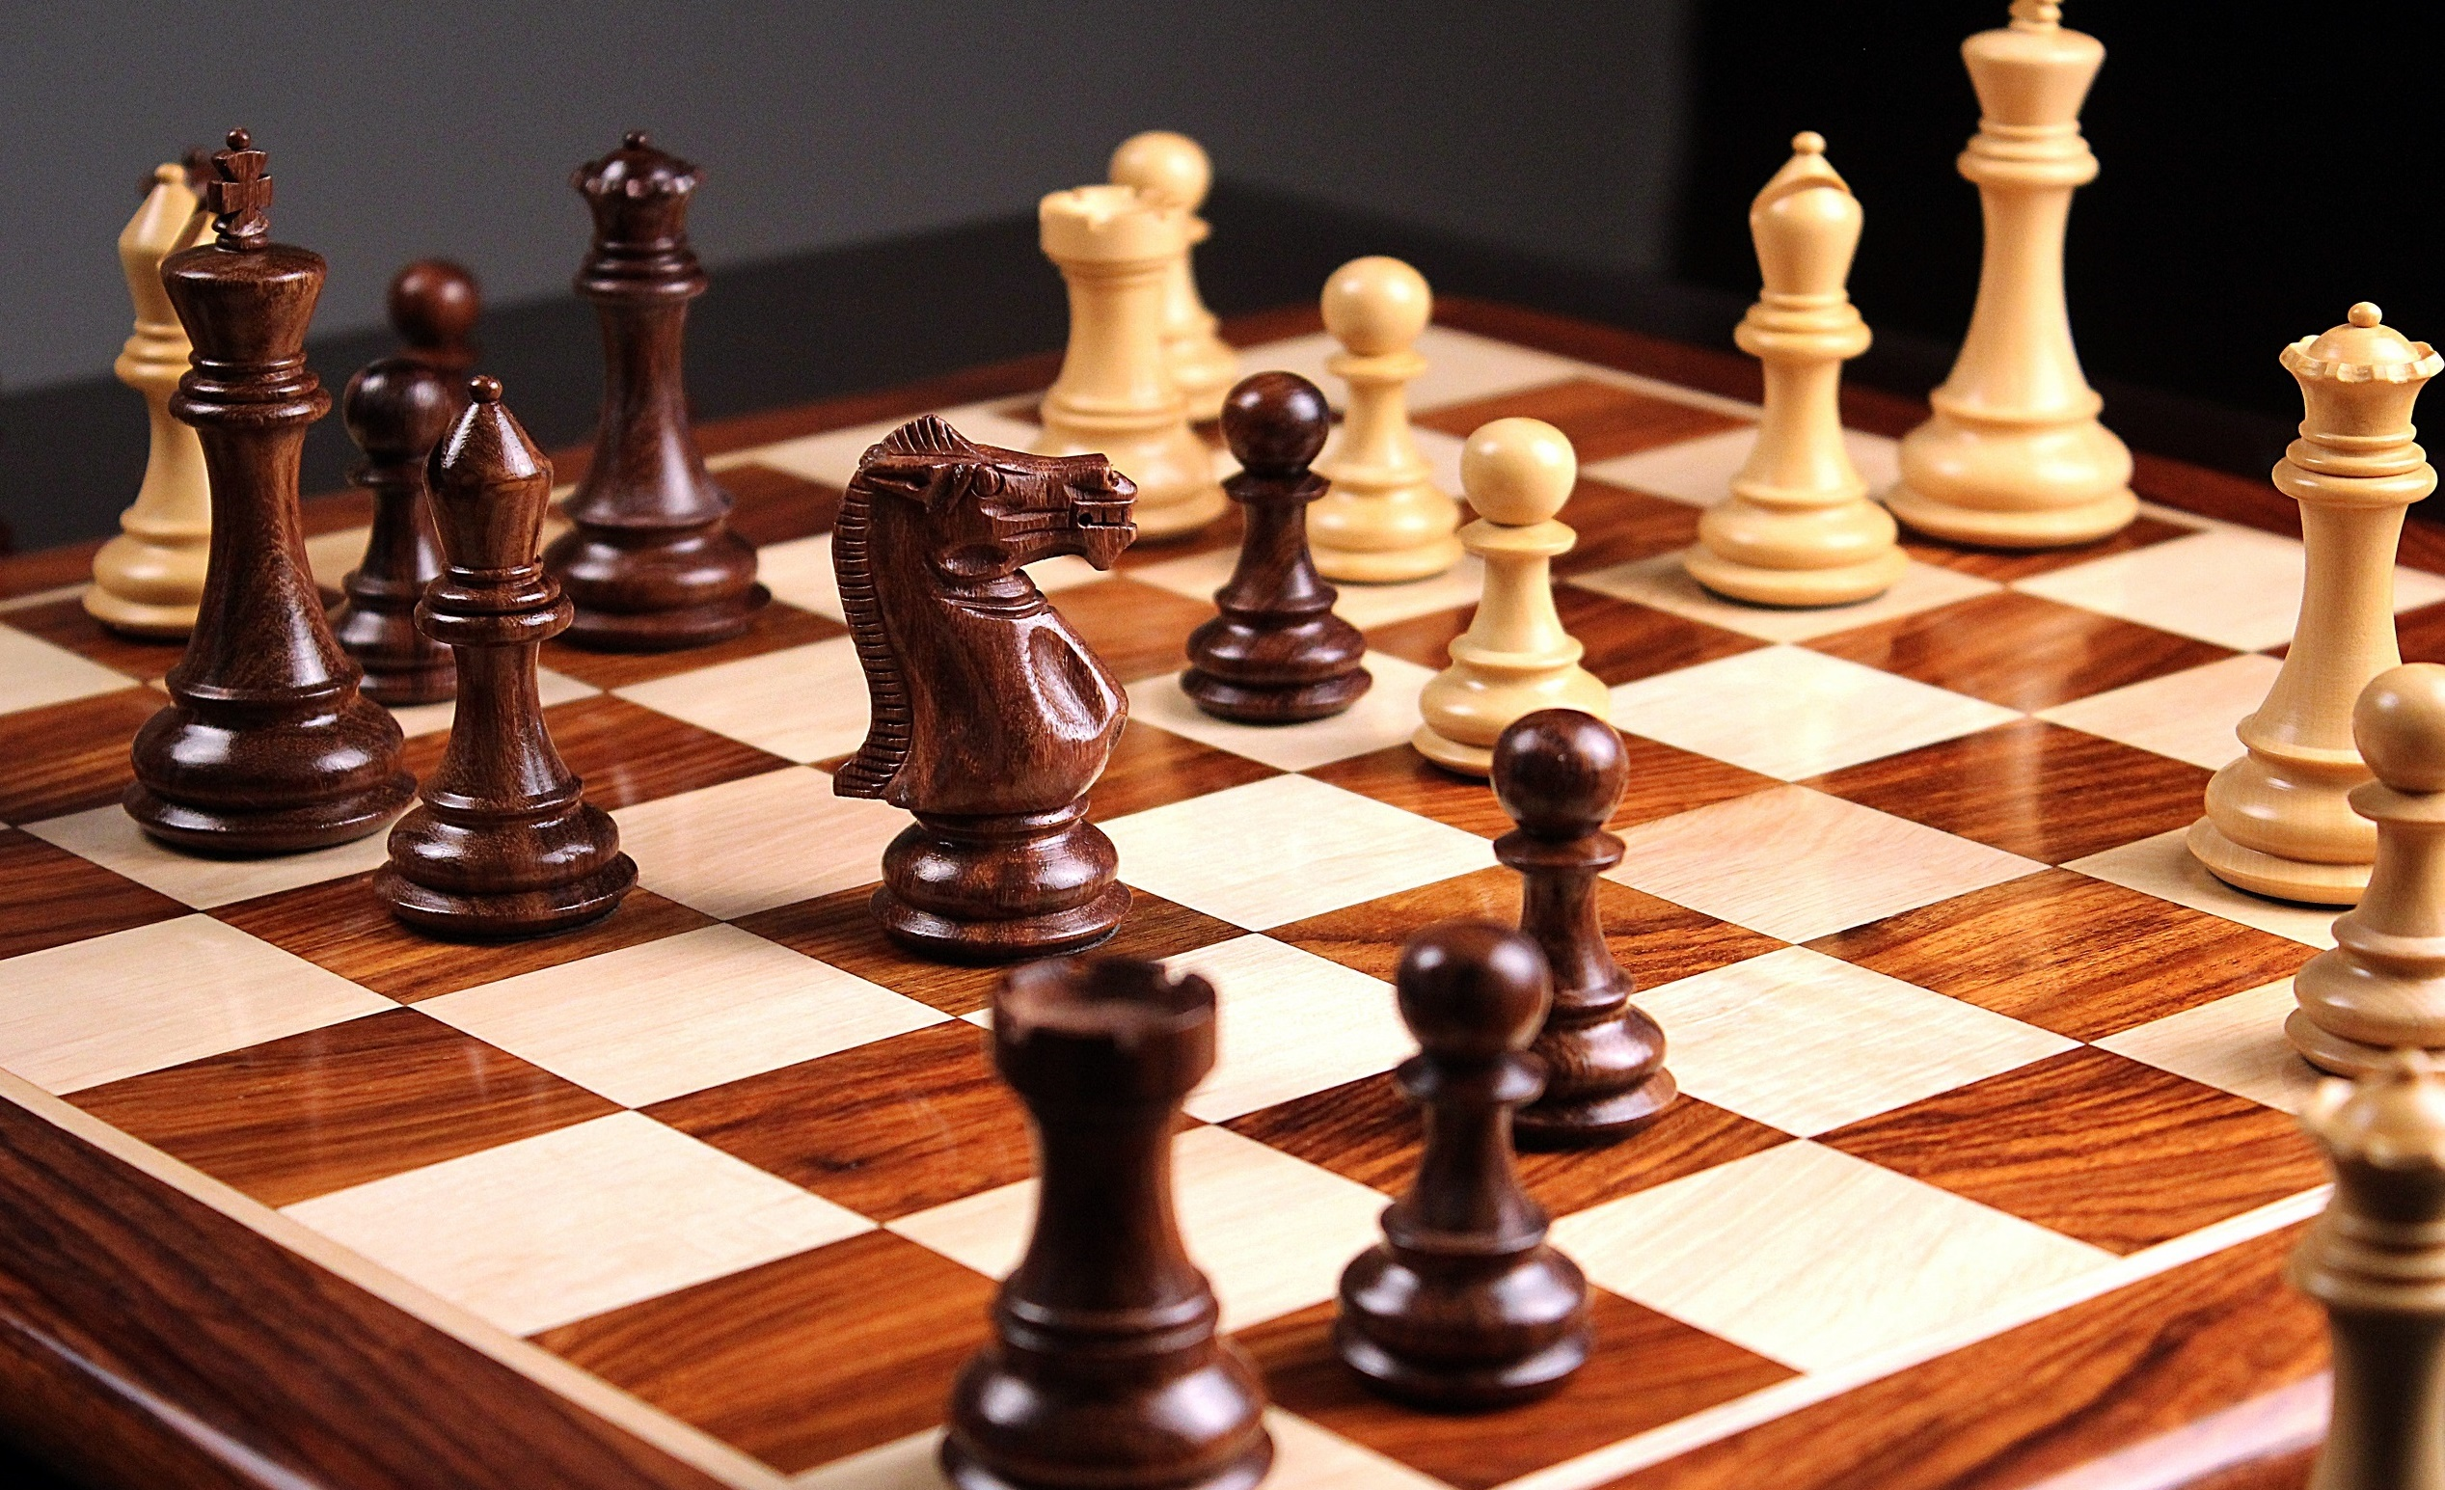

Slide 15
2 Peter 3 v 9
The Lord is not slow to fulfill his promise as some count slowness, but is patient toward you, not wishing that any should perish, but that all should reach repentance.

Slide 16
Worship to God re-established is v-important

Slide 17
Ezra 3 v 1 - 3
When the seventh month came, and the children of Israel were in the towns, the people gathered as one man to Jerusalem.
Then arose Jeshua the son of Jozadak, with his fellow priests, and Zerubbabel the son of Shealtiel with his kinsmen, and they built the altar of the God of Israel, to offer burnt offerings on it, as it is written in the Law of Moses the man of God.
They set the altar in its place, for fear was on them because of the peoples of the lands, and they offered burnt offerings on it to the LORD, burnt offerings morning and evening.

Slide 18
Recognise mistakes but look to the future

Slide 19
Psalm 136
Leader
Give thanks to the LORD, for he is good….
Give thanks to the God of gods…
Give thanks to the Lord of lords…
to him who alone does great wonders…
Response
for his steadfast love endures forever

Slide 20
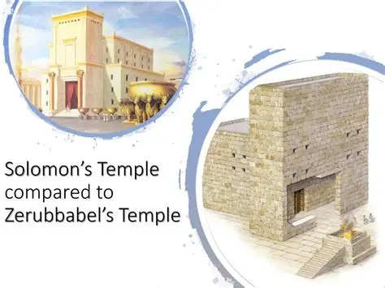

Slide 21
Not unequally yoked to unbelievers

Slide 22
Ezr 4:3 But Zerubbabel, Jeshua, and the rest of the heads of fathers' houses in Israel said to them, “You have nothing to do with us in building a house to our God; but we alone will build to the LORD, the God of Israel, as King Cyrus the king of Persia has commanded us.”

Slide 23
Not unequally yoked to unbelievers

Slide 24
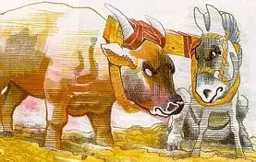

Slide 25
Corinthians 6 v 14 - 16
Do not be unequally yoked with unbelievers. For what partnership has righteousness with lawlessness? Or what fellowship has light with darkness?
What accord has Christ with Belial? Or what portion does a believer share with an unbeliever?
What agreement has the temple of God with idols? For we are the temple of the living God

Slide 26
Opposition must come

Slide 27
1 Peter 5 v 8-9
Be sober-minded; be watchful. Your adversary the devil prowls around like a roaring lion, seeking someone to devour.
Resist him, firm in your faith, knowing that the same kinds of suffering are being experienced by your brotherhood throughout the world.

Slide 28
Exiles
God keeps His promises – Sometimes we have to wait
Worship to God re-established is v-important
Recognise mistakes but look to the future
Not unequally yoked to unbelievers
Opposition must come

